Slide 1
Info 7390 Advances in Data Science and Architecture
Week 3
Data Analysis and Improvement
Bhakti Ukey: ukey.b@northeastern.edu

Slide 2
CONTENT
Demonstrating Data Implementation through Graphics
2. Chart Selection for Specific Analytical Questions
​3. Introduction to principles of Visual Design
4. Basic Visual Designs Principles: Typography, Contrast, and Balance in Data Presentation
​

Slide 3

INTRODUCTION
Why would you want to demonstrate Data Improvements through Graphics?
Visual techniques help us conceptualize and understand complex causal relationships in a more natural and effortless way.
It helps getting insights through :
Visual Communication
Comparison
Identifying Patterns and Anomalies
Engagement
Decision Support

Slide 4
Steps to help create informative graphics
1.Identify your goal: Clearly state the objectives and improvements you want to demonstrate through your data graphics. Are you trying to show reduced errors, increased sales, improved customer satisfaction, or something else?
2.Understand your data: Familiarize yourself with the data you have, such as the variables, their distribution, and the relationships among them. This will help you select a chart highlighting data's most relevant aspects.

Slide 5

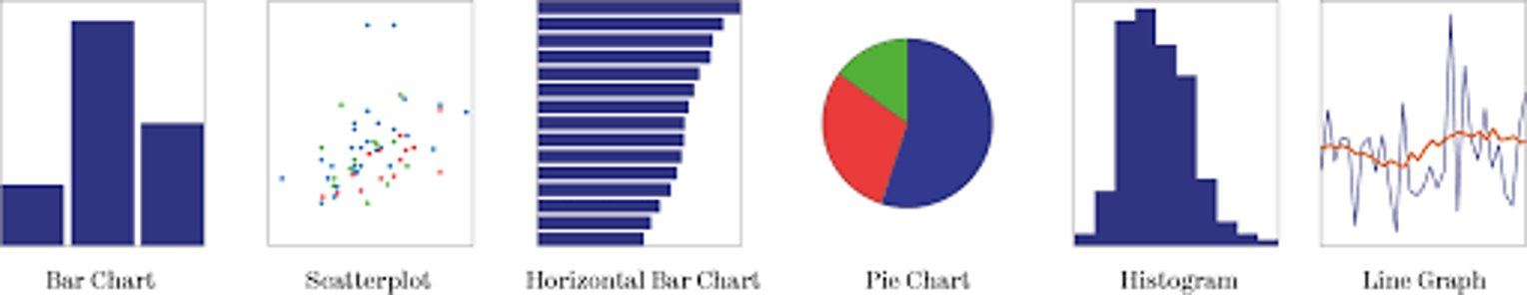
Steps to help create informative graphics
3. Consider the chart types: Different charts address different questions and cater to distinct analytical needs. A few examples of some common charts are:

Slide 6
STEPS TO HELP CREATE INFORMATIVE GRAPHICS
4. Choose a chart that answers the question: Pick the chart that best addresses the question you want to answer based on your understanding of data and chart types.
5.Fine-tune the visualization : Once you have chosen a chart type, refine the design to make it more engaging and accessible to your audience. This includes using appropriate colors, titles, labels, and legends to highlight your key data insights.
6. Use Data Storytelling: Craft a narrative around your graphics. Explain the story behind the data improvements and guide viewers through the key points.

Slide 7


Chart Selection for specific Analytical Questions
As we have established in the previous section that using charts is an excellent way to represent large amounts of information into readable image formats, which
Clearly highlights the points you would like to put across
Decision making
Make Actionable insights
Shows direction

Slide 8
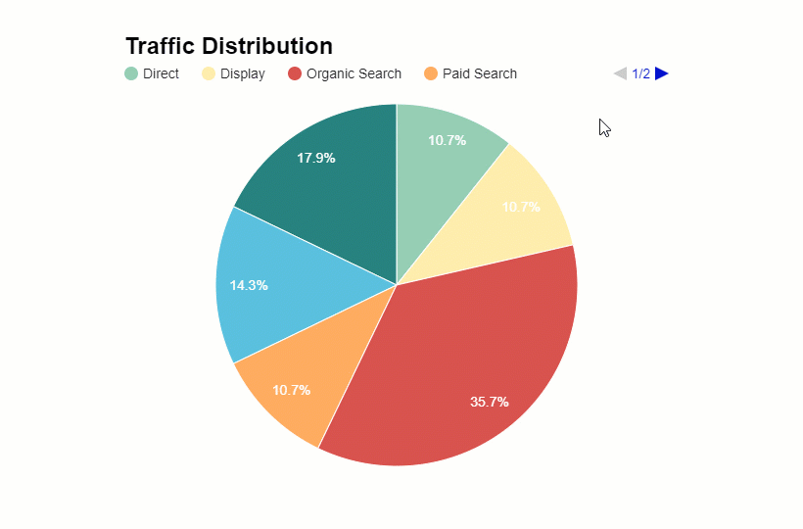
Categories of charts
COMPARISON
COMPOSITION
RELATIONSHIP
DISTRIBUTION
TRENDS

Slide 9
Type of Charts to use for representation
There are many different types of charts which sometimes makes it very difficult to decide which chart type is the best for the need.
1. Bar Graph
2. Line Graph
3. Area Chart
4. Mekko Chart
5. Pie Chart
6. Scatter Plot Chart
7. Bubble Chart
8. Waterfall Chart
9. Funnel Chart
10. Combo Chart
11. Heat Map
12. Waterfall

Slide 10
Types of charts to use for representation
The most used charts out of these are : Bar, Line, Pie, Scatter
Most Often Used for Time Series: - Column (Regular, Clustered, and Stacked), Line, Area
Most Often Used for a Single Point in Time:
Bar (Regular, Clustered, and Stacked),
Pie (Regular, Exploded, and Bar of Pie), Scatter, Bubble
To Show Lot of Information in a Very Small Space: Sparkline, Bullet

Slide 11
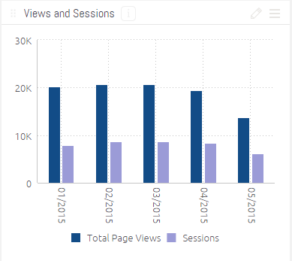
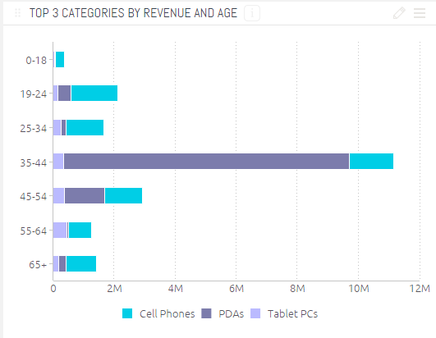
DESCRIPTION OF CHARTS
1. Bar chart – This is the most basic chart type. Each x-axis value corresponds to a bar. The bar height corresponds to its numerical y-axis value.
Vertical Bar Charts: They are best for comparing means or percentages between 2 to 7 different groups, making its cross analysis with happiness perfect for a vertical bar chart. when comparing categories that are mutually exclusive.
Horizontal Bar Charts: when comparing categories that are mutually exclusive. more than 7 categories of candy were measured independently and are being compared to one another.

Slide 12
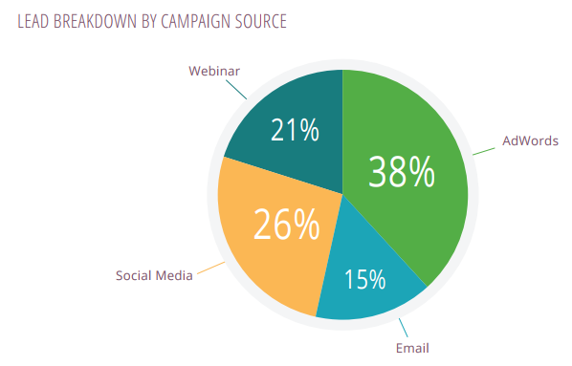
Description of charts
2. Pie chart – A pie chart is a circular graph that represents data as slices of a pie or as segments of a circle. Each slice, or sector, in a pie chart corresponds to a specific category or data point, and the size of each slice is proportional to the quantity it represents within the whole dataset. Pie charts are useful for displaying the distribution of data across categories or showing the relative proportions of different components within a whole

Slide 13
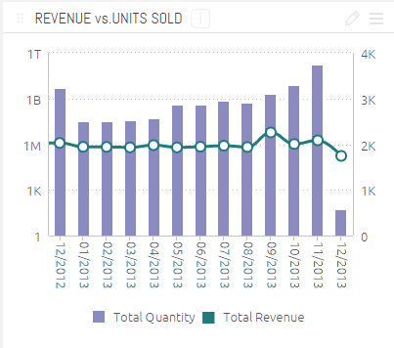
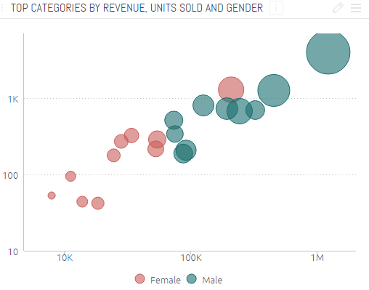
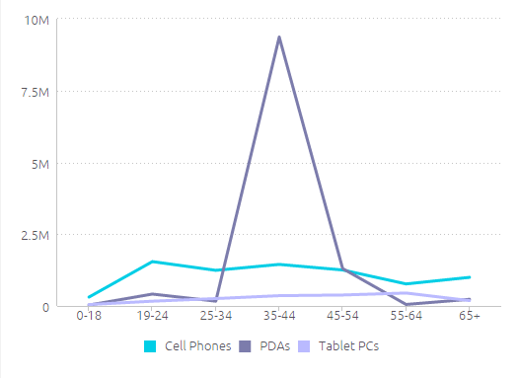
Description of charts
3. Combo chart – The combo chart allows the combination of the features of the bar chart with those of the line chart. One expression will be displayed by lines and/or symbols, the other as bars.
4. Scatter chart – The scatter chart plots data points representing combinations of expressions, iterated over one or several dimensions. Both axes are continuous, representing one expression each. Normally used to depict how different objects settle around a mean based on 2 to 3 different dimensions. Allows for quick and easy comparisons between competing variables.
5. Line chart - A line chart is a type of graph that displays data points connected by straight lines. It is commonly used to show trends, changes, and variations in data over time or across different categories. Line charts are particularly effective for visualizing continuous data and illustrating how values evolve sequentially.
Area Graph: Good to use when you are tracking the changes in two or more related groups that make up one whole category

Slide 14
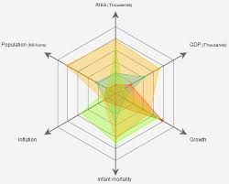
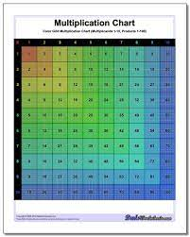
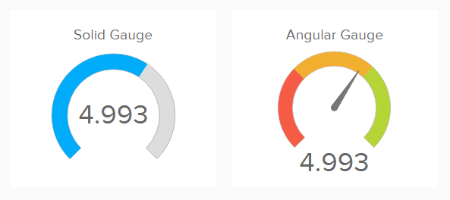
Description of charts
6. Radar chart – The radar chart is a variant of the line chart where the x-axis is plotted in a circle around the chart, resulting in a projection reminiscent of a radar screen or a spider’s web.
7. Grid chart – The grid chart is a variant of the scatter chart that plots dimension values on the axes and uses an expression to determine the plot symbol. It can also show a third dimension in the form of small pie charts as plot symbols.
8. Gauge chart – Gauge charts are used to display the value of a single expression, lacking dimensions.

Slide 15
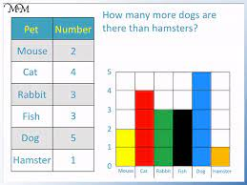
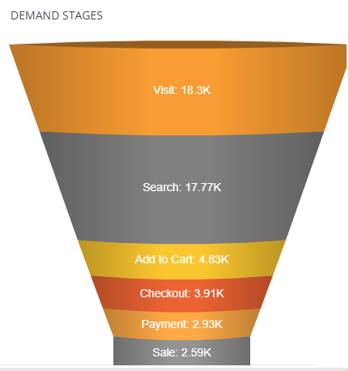
Description of charts
9. Block chart – The block chart shows the relation between expression values as blocks of varying area. It uses a single expression and up to three dimensions, with each dimension block further divided into sub-blocks. The total area of the block chart always equals 100% of the possible expression values.
10. Funnel chart – The funnel chart is typically used for showing data in flows and processes. From a display standpoint it is related to the pie chart. The chart may be shown with either segment height/width or segment area proportional to data. It is also possible to draw the chart with equal segment heights/widths without regards to data points.

Slide 16
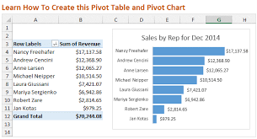
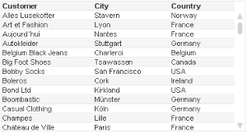
Description of charts
11. Pivot table – The pivot table presents dimensions and expressions in table form. There is no formal limit to the number of dimensions or expressions possible. A pivot table can be defined without expressions, generating a tree view for navigating the dimension levels.
12. Straight table – The straight table differs from the pivot table in that it cannot display subtotals and that the grouping of dimensions is shown in record form so that each row of the table contains field and expression values.

Slide 17
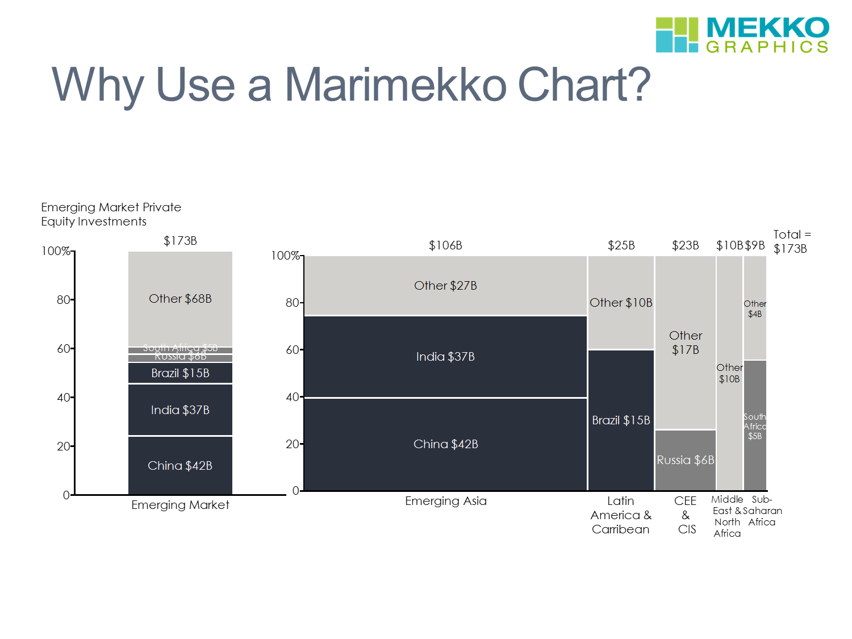
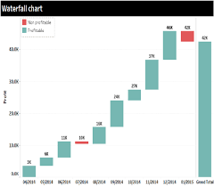
Description of charts
13. Mekko chart – Mekko charts present data using variable width bars. They can display up to three levels of data in a two-dimensional chart. Mekko charts are useful in such areas as market analysis.
14. Waterfall charts - used to explain changes in Performance/Revenue. i.e. explain the change in earnings from one year to the next. One can use for many other uses. For example
- Explaining how operating costs changed from one time-period to the next.
- Steps from Cost to Company to Revenue
- Units in stock to Salable unit

Slide 18
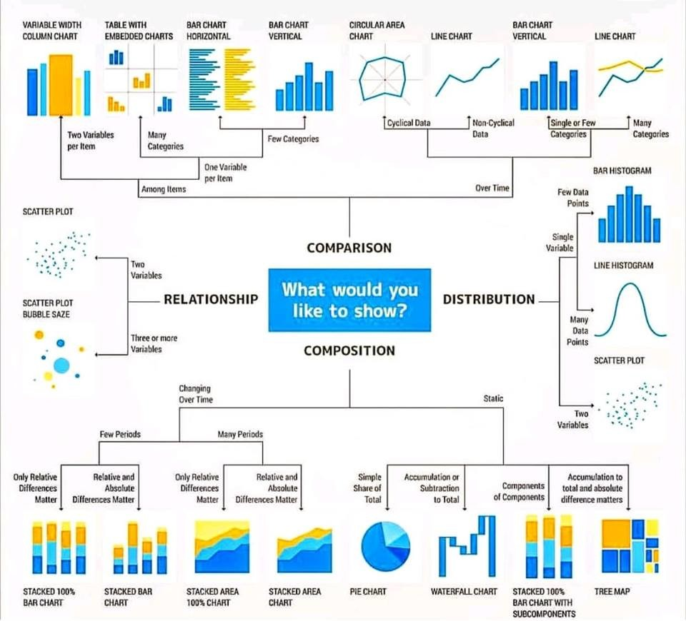
When to use which chart?

Slide 19
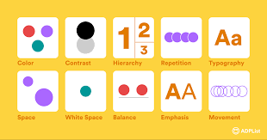
INTRODUCTION TO PRINCIPLES OF VISUAL DESIGN
Visual design focuses on the aesthetics of a site and its related materials by strategically implementing images, colors, fonts, and other elements. A successful visual design does not take away from the content on the page or function. Instead, it enhances it by engaging users and helping to build trust and interest in the brand.
There is no real consensus in the design community about what the main principles of design actually are. That said, the following twelve principles of visual design are those mentioned most often
Basic Visual Design : Contrast, Balance, Typography
Advanced Visual Design : Emphasis, Proportion, Hierarchy, Repetition, Rhythm, Pattern, White Space, Movement, Variety, Unity.

Slide 20
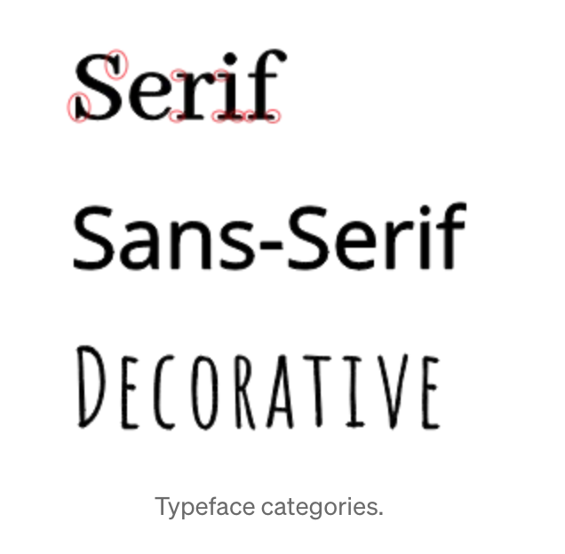
VISUAL DESIGN PRINCIPAL
Let's discuss the Basic Visual Design principals below:
Typography
Typography refers to the way text is arranged in a design. That includes the fonts used, their spacing, size, and weight, and the way different text elements relate to each other.
There are seven basic, universal typographical design elements: typeface, hierarchy, contrast, consistency, alignment, white space, and color.
Typeface : There are three basic kinds of typefaces: serif, sans-serif, and decorative

Slide 21


VISUAL DESIGN PRINCIPAL
2. Hierarchy
Hierarchy helps keep your ideas organized, so that viewers can always identify which category of information they are reading.
A typical example would be a website, where the title of the site is at the top of the page in a large header, while main navigation pages within the website are listed below the header in a smaller font.

Slide 22
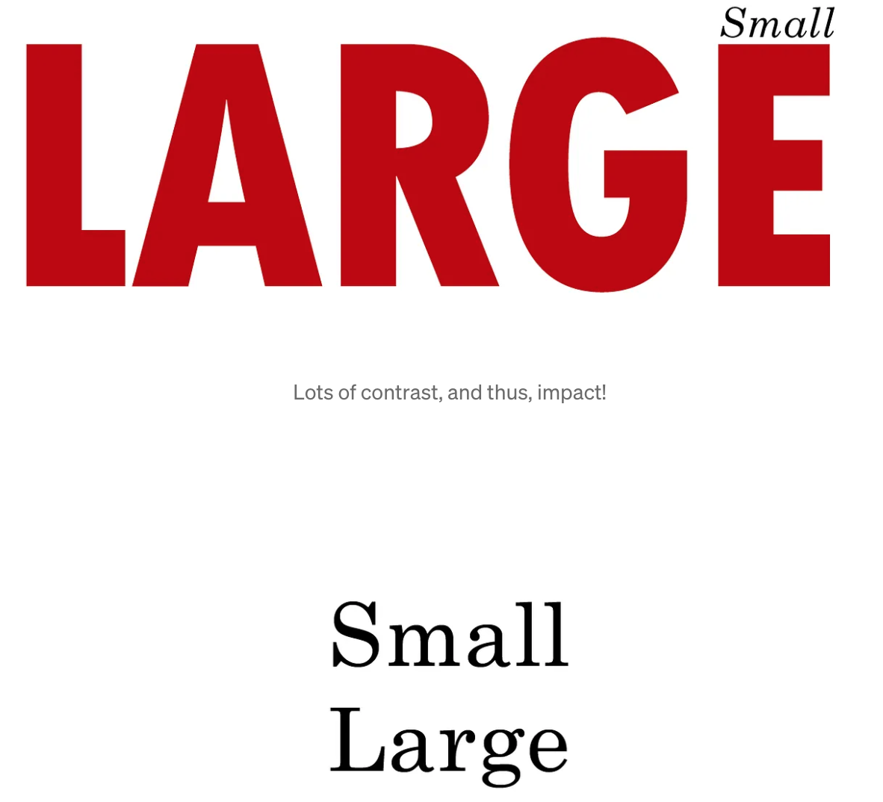
VISUAL DESIGN PRINCIPAL
3. Contrast
Contrast makes text interesting and can help you communicate which ideas you want to emphasize. Varying size, typeface, weight, color, and style can give your designs a big impact as well as make your ideas organized.
Below, you can see how contrast helps you to give your text an interesting, attention-grabbing, and even more meaningful appearance. Below, the word “Small” is black, aligned right, lightweight, in an italic serif typeface with increased space between letters. “Large” is red, heavy weight, in a regular sans-serif typeface, and is about 10x bigger than the word “Small.”

Slide 23
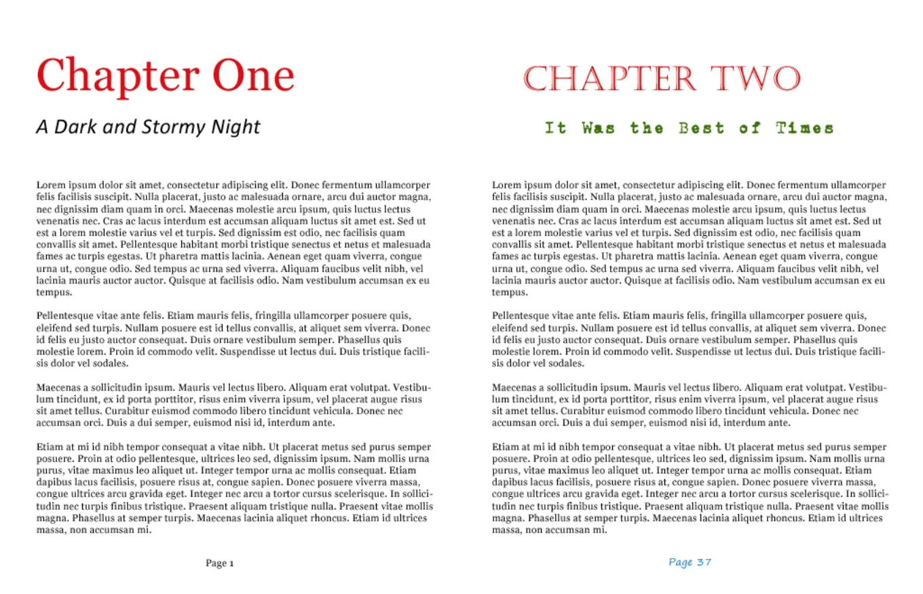
VISUAL DESIGN PRINCIPAL
4. Consistency
Consistency is a key principle for all typography. Consistent fonts are especially important, as using too many can lead to a confusing and messy look, so always use the same font styling for the same information.
The “Chapter One” page below has a pleasing design with only two font faces, two colors, and three font sizes. Even though only two font faces are used, hierarchy is achieved by using size and color.
The “Chapter Two” page, there are four different font faces, four colors, four font sizes, and each element has a different alignment — all of this creates a messy, unattractive design.

Slide 24
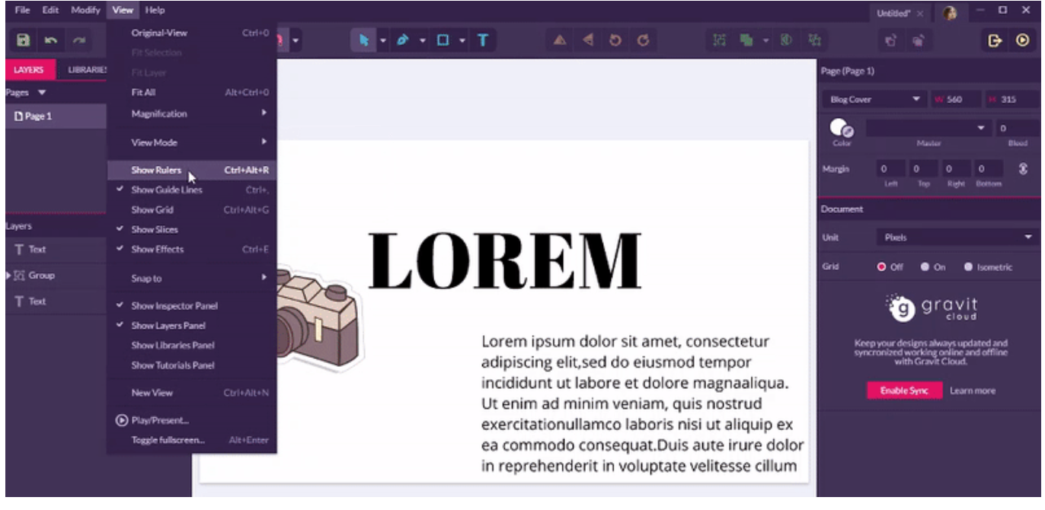
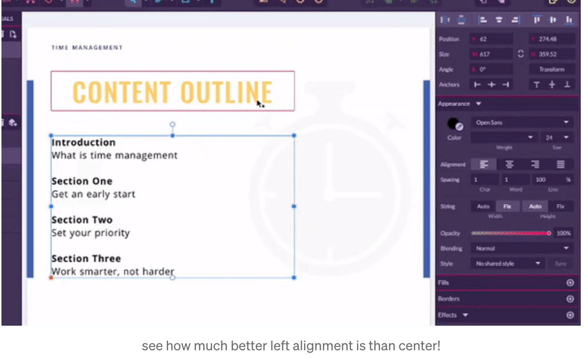
VISUAL DESIGN PRINCIPAL
Alignment refers to the “line,” that the text orients towards. It can apply to a whole body of text, individual words, or even images.
Alignment should be as consistent as possible and every element of your design is meant to align to one of the other elements in some way, to create equal sizes and distances between objects.
For example, you may want the logo to align in size with your header, and you may want your body text to align with the same margins the header falls in.
Many amateur designers make the mistake of overusing center alignment, it is tempting but can be messy and look imbalanced.
Left alignment is usually the best choice, and right alignment can also be interesting. However, avoid using right alignment for body text
5. ALIGNMENT

Slide 25
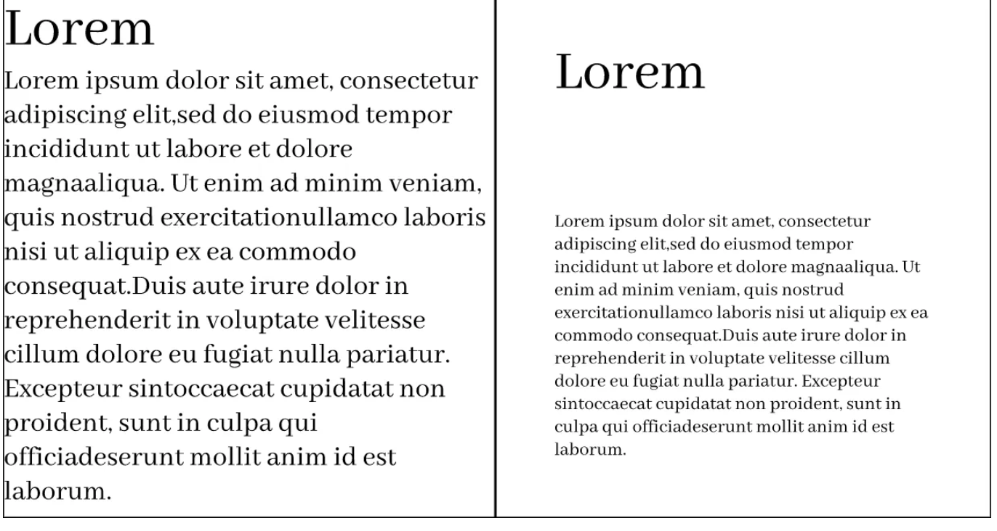
VISUAL DESIGN PRINCIPAL
6. Whitespace
Whitespace refers to the empty space around objects or text, and can take the form of margins, padding, or just an uncluttered area.
It creates a pleasing visual experience and can even draw attention to text.
In the first box below, the text is crammed against the bounding box, making it hard to read.
In the second box, the text has breathing room and the design even looks more stylish.

Slide 26

VISUAL DESIGN PRINCIPAL
7. Color
Color can really help to set the mood for your design, and getting it right can make your text stand out. There are three main components of color:
Hue — the shade of color
Saturation — how brilliant the color is
Value — lightness or darkness of the color

Slide 27

VISUAL DESIGN PRINCIPAL
BALANCE
Balance in design covers how elements are weighted against each other on different sides of a design to create cohesiveness, completion, and satisfaction. Your composition should be balanced vertically, horizontally, diagonally

Slide 28
VISUAL DESIGN PRINCIPAL
The five types of balance covered here are:
Symmetrical
Asymmetrical
Radial
Mosaic
Discordant

Slide 29

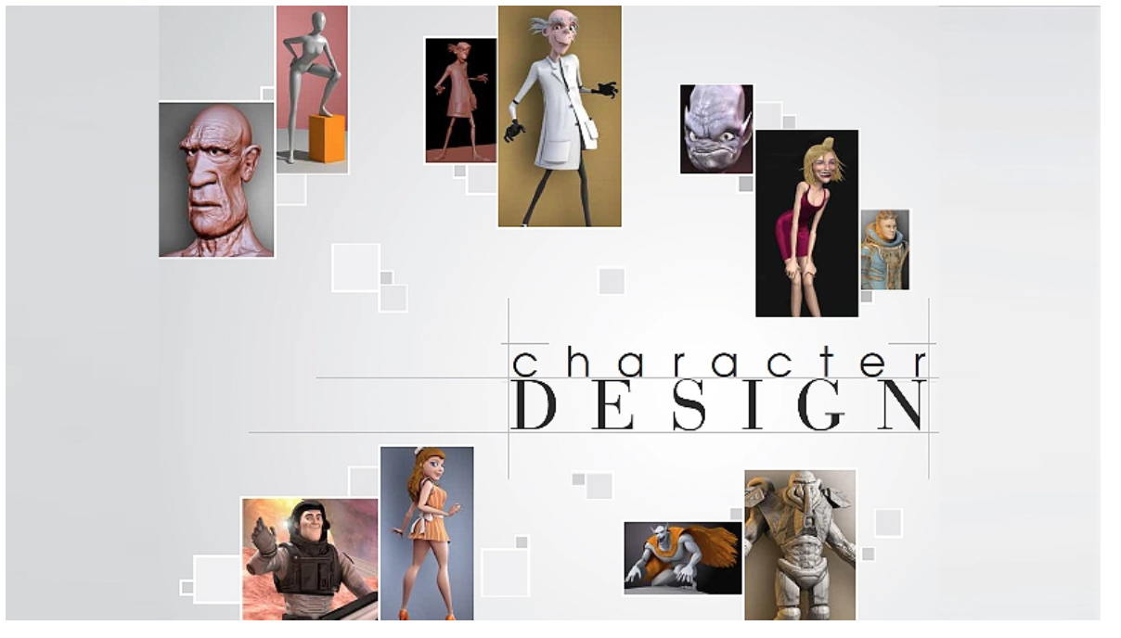
TYPES OF bALANCE
Symmetrical Balance
With symmetrical balance, the visual weight is distributed evenly.
You can draw a straight line through the middle of the design in any direction and the visual balance would be evenly distributed.
This makes the composition appear stable and creates a more orderly look.
2. Asymmetrical balance
An asymmetrical composition is intended to create a deliberate imbalance of the elements in the design.
Asymmetricality can create tension and give your composition a sense of movement.

Slide 30
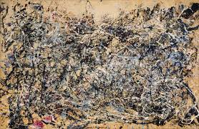
TYPES OF BALANCE
5. Discordant (Off-Balance)
There are times when you want to make your design uncomfortable to your viewers.
Maybe you want them to stop and think, or move and take action.
An example of this being used is in typography.
If the designer wants you to focus on something specific, like a brand name, discordant design can do the trick.
3. Radial balance
Rather than balancing both sides of a centered line, you can also choose to use radial balance around a single point (like a snowflake).
Balance can be attained through placing objects, colors, or textures at equal distances from the center, or in the same way as balancing a seesaw.
4. Mosaic Balance
Sometimes called crystallographic balance, mosaic balance is a type of organized chaos.
It may look like “noise” at first because of a distinct lack of focal point, but upon closer inspection you will find that it all works together when the elements share some type of uniform emphasis.
An example of mosaic balance is a painting by Jackson Pollock.

Slide 31
When making any design, asking yourself these three questions will help you recall the aforementioned guidelines and principles:
Is my text readable?
Is my styling consistent?
Does my styling use contrast?

Slide 32
THANK YOU
Bhakti Ukey
Ukey.b@northeastern.edu

